Slide 1

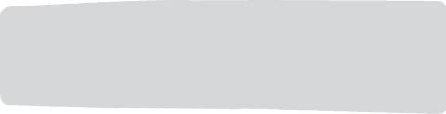
Mobile Apps Design
Postgrado en
VIEWS AND LAYOUTS
Juan Luis Gorricho

Slide 2
USER INTERFACE
The user interface is built using View and
ViewGroup objects
Subclasses of View, the “widgets”, are implementations of the View class, e.g. Button, TextView, etc.
Subclasses of ViewGroup, the “layouts”, implement the arrangement of View elements inside a container (the view group): linear, tabular, relative, etc.

Slide 3
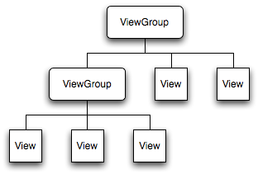

USER INTERFACE
The UI associated to an activity is defined by a hierarchy of View objects, using a View object as the root and parameter of: setContentView(view), this method is usually called from onCreate() to create the activity.

Slide 4
USER INTERFACE
The drawing of the view is made from the root view downwards to the leaves, this way descendent views take their references on dimensions and location from their parent already drawn.
The geometry of any view is rectangular. The view location is defined by its coordinates: (left, top) and dimensions (width, height)
If there’s some overlapping, the last drawn views will be shown on top of the previously drawn.

Slide 5

LAYOUTS
To define a layout there are two methodologies:
  Using an XML file.
  By code, instantiating and composing the layout on run time.

Slide 6



DECLARATIVE LAYOUT
Example of a declarative layout:
<?xml version="1.0" encoding="utf-8"?>
<LinearLayout xmlns:android="http://schemas.android.com/apk/res/android" android:layout_width="fill_parent" android:layout_height="fill_parent"
android:orientation="vertical" >
<TextView android:id="@+id/text" android:layout_width="wrap_content" android:layout_height="wrap_content" android:text="Hello, I am a TextView" />
<Button android:id="@+id/button" android:layout_width="wrap_content" android:layout_height="wrap_content" android:text="Hello, I am a Button" />
</LinearLayout>

Slide 7



CODED LAYOUT
LinearLayout layout = new LinearLayout(this);
layout.setLayoutParams(new LinearLayout.LayoutParams(LayoutParams.FILL_PARENT, LayoutParams.FILL_PARENT));
layout.setOrientation(LinearLayout.VERTICAL);
TextView tv = new TextView(this); tv.setText("Hello, I am a TextView"); tv.setLayoutParams(new
LinearLayout.LayoutParams(LayoutParams.WRAP_CONTENT, LayoutParams.WRAP_CONTENT));
Button btn=new Button(this); btn.setText("Hello, I am a Button"); btn.setLayoutParams(new
LinearLayout.LayoutParams(LayoutParams.WRAP_CONTENT, LayoutParams.WRAP_CONTENT));
layout.addView(tv); layout.addView(btn);

Slide 8
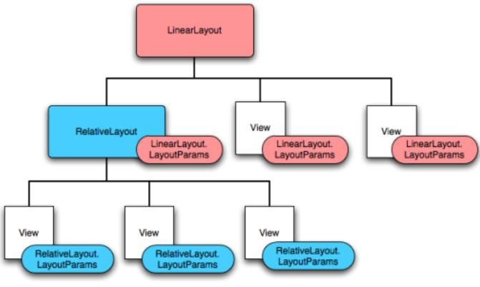

LAYOUT PARAMETERS
Any View object can set its layout parameters to indicate how to allocate itself inside its container (ViewGroup):

Slide 9

BASIC WIDGETS
The widgets are a library of fully implemented View classes contained within the package: android.widget. Examples of basic widgets are:
  Button, ToggleButton, ImageButton
  ImageView, TextView, EditText
  CheckBox, RadioButton
  CalendarView, DatePicker, etc.

Slide 10
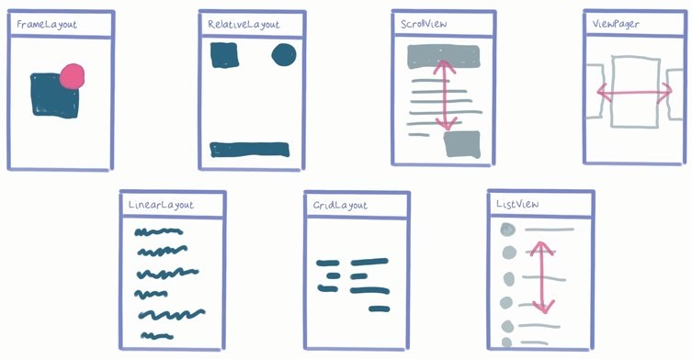



LAYOUTS

Slide 11

XML ATTRIBUTES
of ViewGroup.LayoutParams:
  android:layout_height
  android:layout_width
of ViewGroup.MarginLayoutParams:
  android:layout_marginBottom
  android:layout_marginLeft
  android:layout_marginRight
  android:layout_marginTop

Slide 12

PADDING AND MARGINS

Slide 13

XML ATTRIBUTES
of FrameLayout.LayoutParams:
  android:layout_gravity
of LinearLayout.LayoutParams:
  android:layout_gravity
  android:layout_weight
of RelativeLayout.LayoutParams:
  android:layout_above
  android:layout_below
  android:layout_alignBottom
  android:layout_alignParentBottom
  android:layout_toLeftOf
  etc.

Slide 14
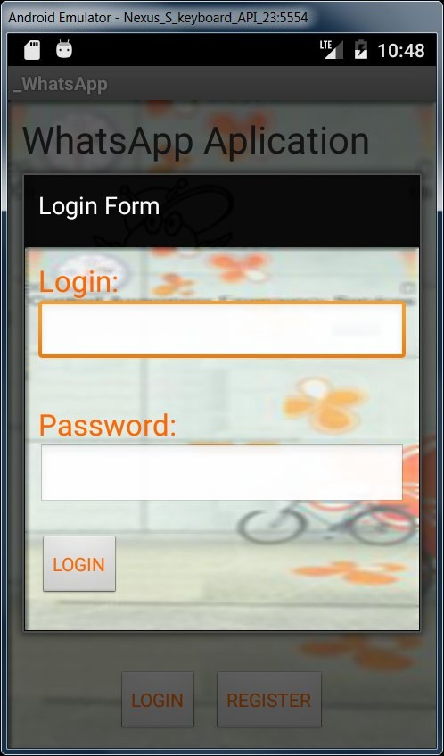

EXERCISE
Complete the b_login layout to have a form like this:

Slide 15
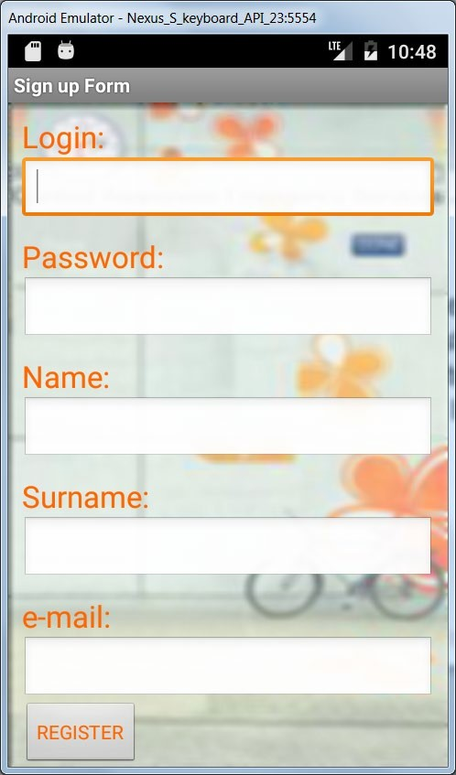

EXERCISE
Complete the c_registration layout to have a form like this:

